Slide 1
Learning Objective
I will be able to calculate the area between curves determined by functions of the form 𝑦 =𝑓(𝑥)
Success Criteria
At the end of the lesson, I will be able to:
calculate the area between curves determined by functions of the form 𝑦 =𝑓(𝑥)

Slide 2
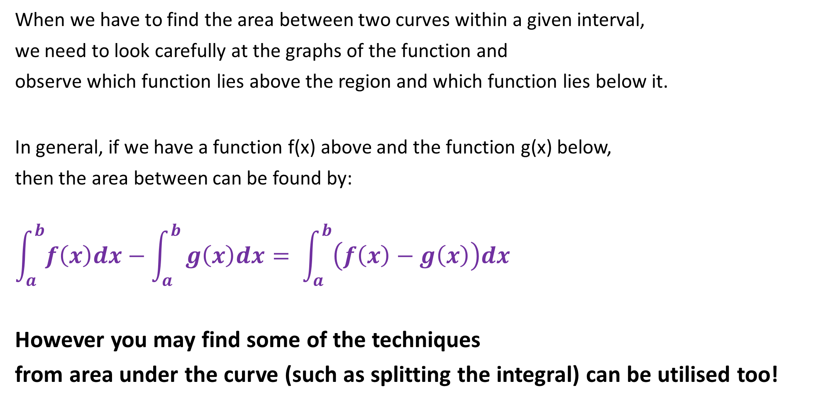
The Area Between Curves
When we have to find the area between two curves within a given interval,
we need to look carefully at the graphs of the function and
observe which function lies above the region and which function lies below it.
In general, if we have a function f(x) above and the function g(x) below,
then the area between can be found by:
$$\int_{a}^{b}{f\left(x\right)dx}−\int_{a}^{b}{g\left(x\right)dx= \int_{a}^{b}{\left(f\left(x\right)−g\left(x\right)\right)dx}}$$
However you may find some of the techniques
from area under the curve (such as splitting the integral) can be utilised too!

Slide 3

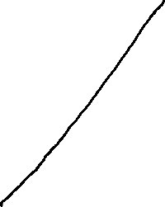

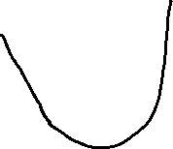
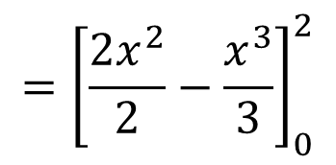
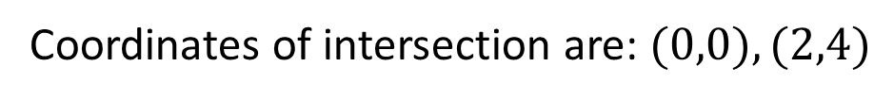
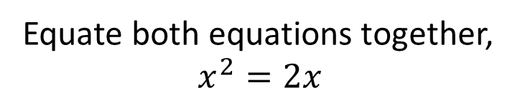
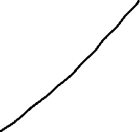
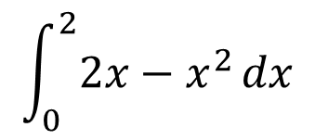
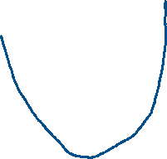


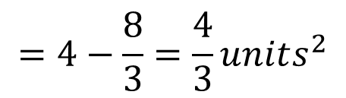

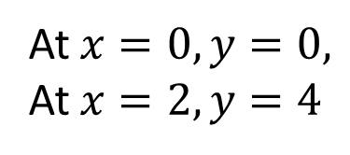
Guided Practice
Find the area of the region bounded by the parabola $y=x^{2}$ and the line$y=2x$
Step 1: Sketch the graph
Step 2: Determine the coordinates of intersection
Equate both equations together,
$$x^{2}=2x$$
$$x^{2}−2x=0$$
$$x(x−2)=0$$
$$x=0, x=2$$
At $x=0, y=0,$
At $x=2, y=4$
Coordinates of intersection are: $(0,0), (2,4)$
Step 3: Determine the area of required
$$\int_{0}^{2}{2x−x^{2}}dx$$
$$={\left[\frac{{2x}^{2}}{2}−\frac{x^{3}}{3}\right]}_{0}^{2}$$
$$=4−\frac{8}{3}=\frac{4}{3}units^{2}$$

Slide 4
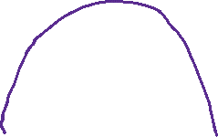
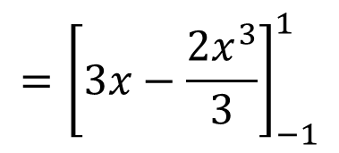
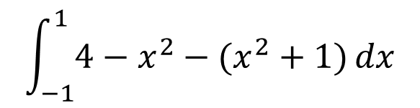
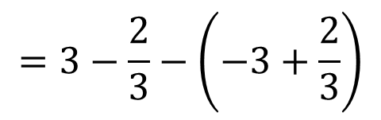
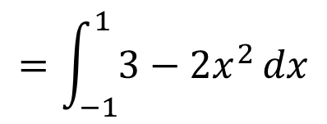
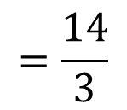


Guided Practice
Find the area of the region bounded by the curves with equations $y=x^{2}+1, y=4−x^{2}$ and the line $x=−1$ and $x=1$.
Step 1: Sketch the graphs
$$\int_{−1}^{1}{4−x^{2}−(x^{2}+1)}dx$$
$$=\int_{−1}^{1}{3−2x^{2}}dx$$
$$={\left[3x−\frac{{2x}^{3}}{3}\right]}_{−1}^{1}$$
$$=3−\frac{2}{3}−\left(−3+\frac{2}{3}\right)$$
$$=\frac{14}{3}$$

Slide 5
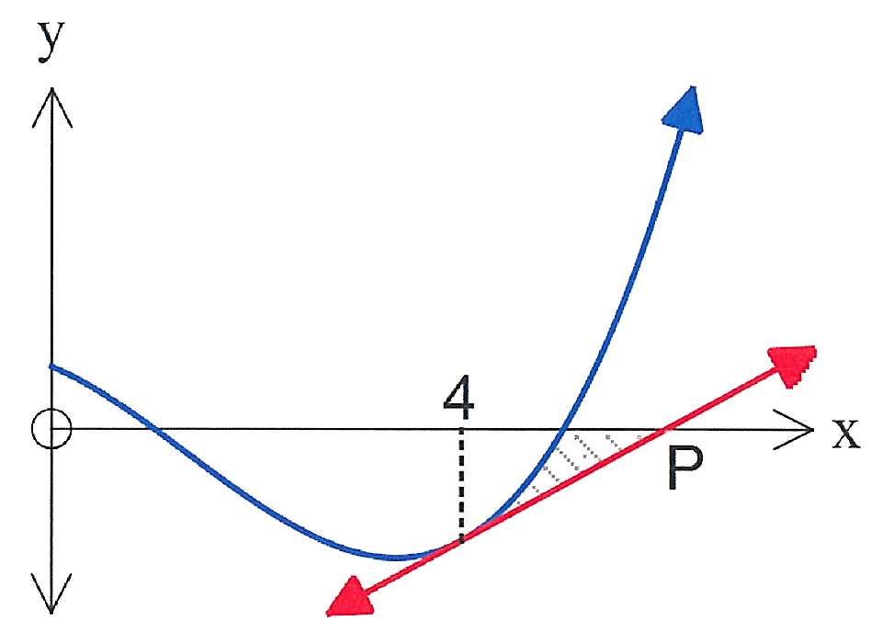
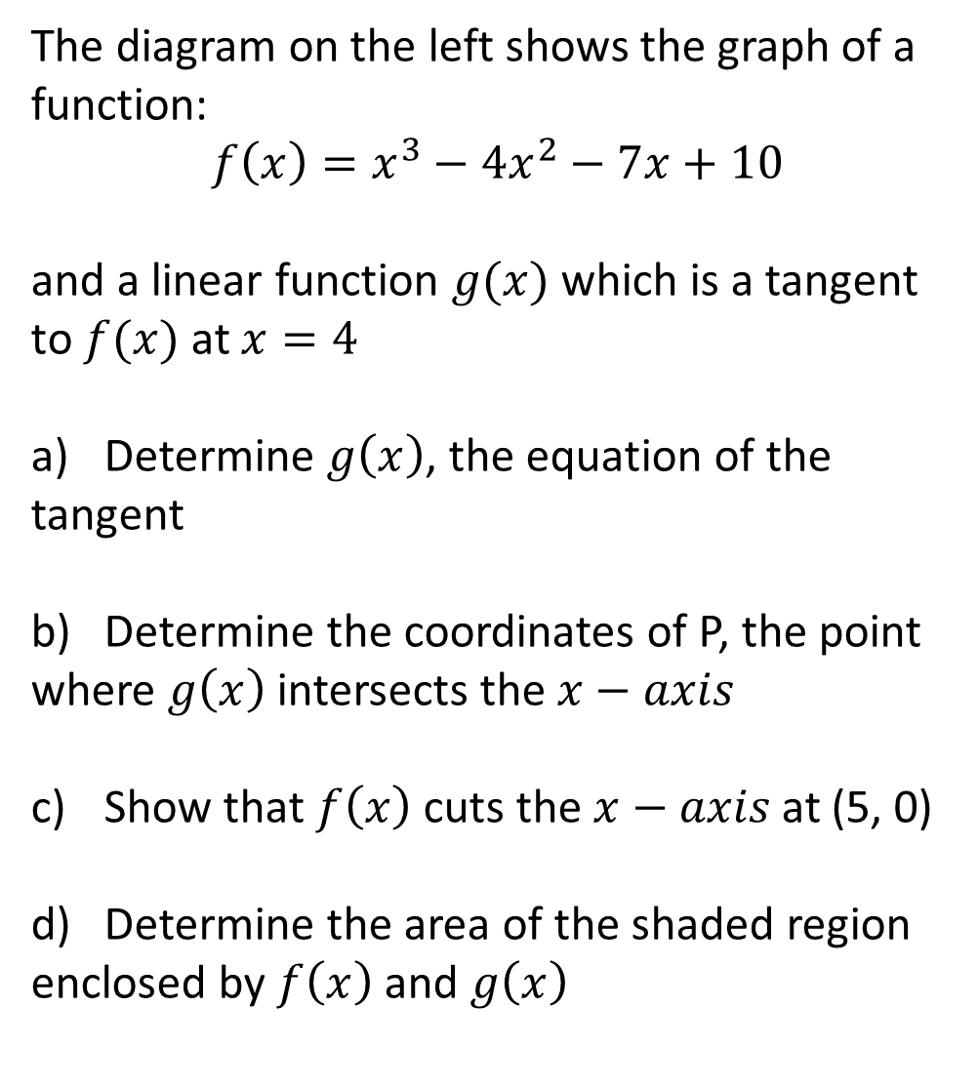
Guided Practice
The diagram on the left shows the graph of a
function:
$$f\left(x\right)=x^{3}−4x^{2}−7x+10$$
and a linear function $g(x)$ which is a tangent
to $f(x)$ at $x=4$
Determine $g\left(x\right)$, the equation of the
tangent
Determine the coordinates of P, the point
where $g\left(x\right)$ intersects the $x−axis$
Show that $f\left(x\right)$ cuts the $x−axis$ at (5, 0)
Determine the area of the shaded region
enclosed by $f\left(x\right)$ and $g\left(x\right)$

Slide 6








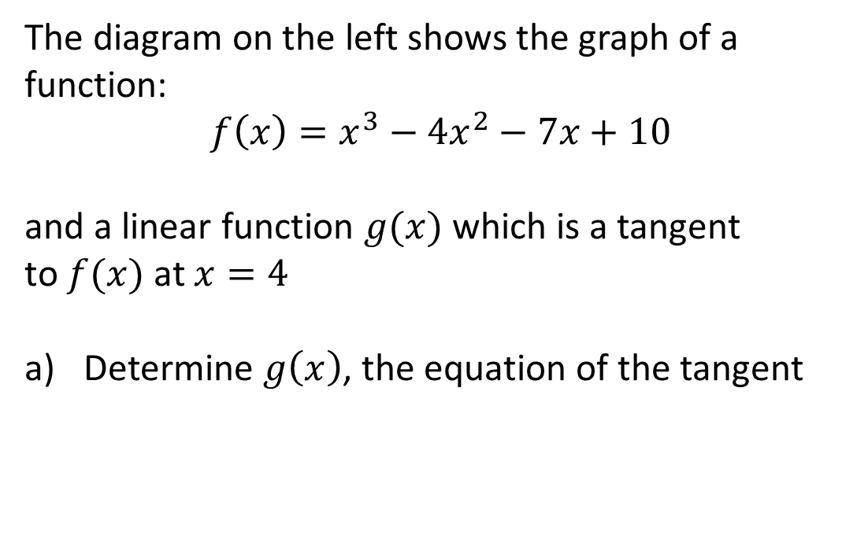

Guided Practice
The diagram on the left shows the graph of a
function:
$$f\left(x\right)=x^{3}−4x^{2}−7x+10$$
and a linear function $g(x)$ which is a tangent
to $f(x)$ at $x=4$
Determine $g\left(x\right)$, the equation of the tangent
$$y=9x+c$$
$$−18=9(4)+c$$
$$c=−54$$
$$f^{′}\left(x\right)=3x^{2}−8x−7$$
$$∴g(x)=9x−54$$
$$f^{′}\left(4\right)=3{(4)}^{2}−8(4)−7$$
$$=9$$
$$f\left(4\right)={\left(4\right)}^{4}−4{\left(4\right)}^{2}−7\left(4\right)+10$$
$$=−18$$

Slide 7
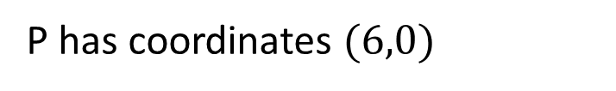


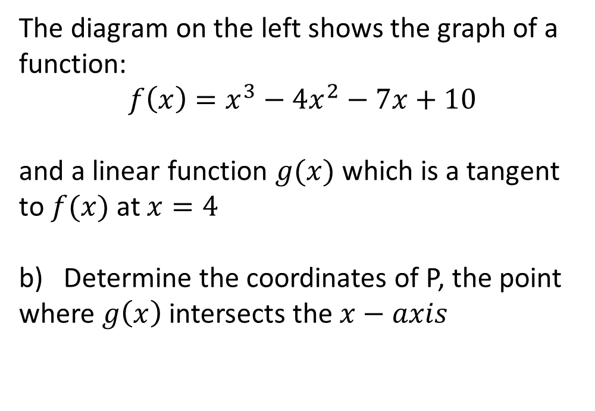
Guided Practice
The diagram on the left shows the graph of a
function:
$$f\left(x\right)=x^{3}−4x^{2}−7x+10$$
and a linear function $g(x)$ which is a tangent
to $f(x)$ at $x=4$
Determine the coordinates of P, the point
where $g\left(x\right)$ intersects the $x−axis$
Subst g(x)=0
$$0=9x−54$$
$$x=6$$
P has coordinates $(6,0)$

Slide 8

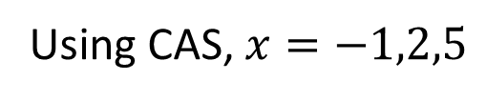

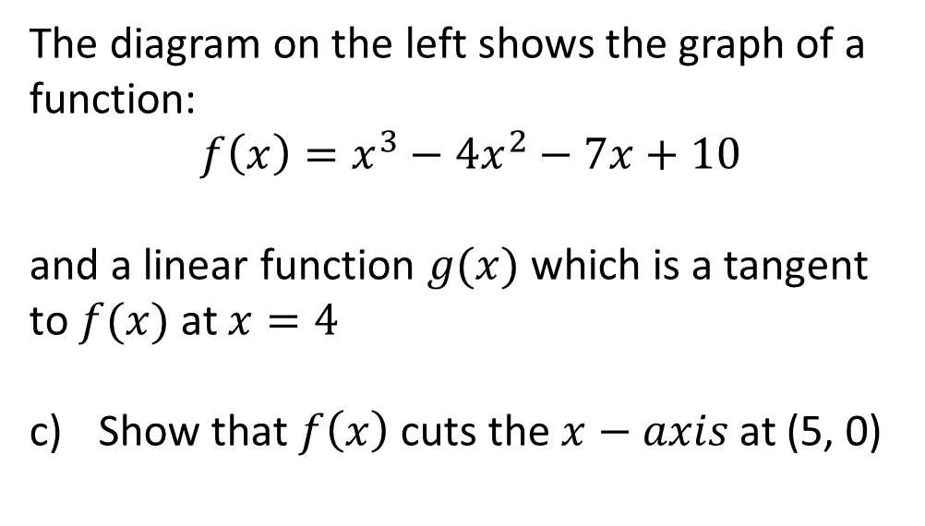
Guided Practice
The diagram on the left shows the graph of a
function:
$$f\left(x\right)=x^{3}−4x^{2}−7x+10$$
and a linear function $g(x)$ which is a tangent
to $f(x)$ at $x=4$
Show that $f\left(x\right)$ cuts the $x−axis$ at (5, 0)
Subst f(x)=0
$$x^{3}−4x^{2}−7x+10=0$$
Using CAS, $x=−1,2,5$
$∴\left(5,0\right)is an x−intercept of f(x)$

Slide 9
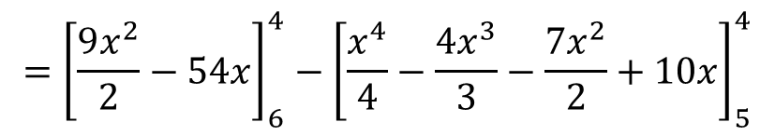
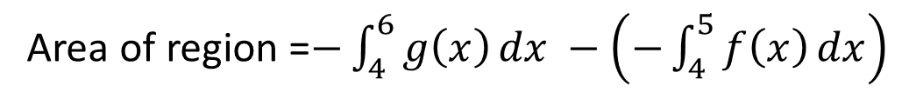


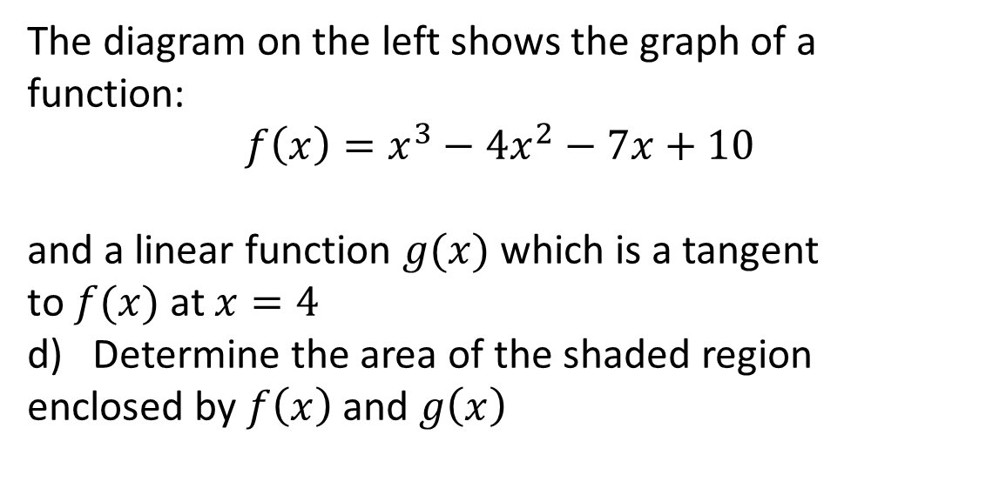
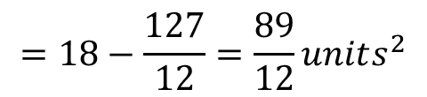
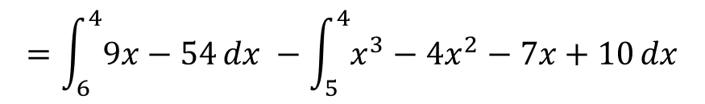

Guided Practice
The diagram on the left shows the graph of a
function:
$$f\left(x\right)=x^{3}−4x^{2}−7x+10$$
and a linear function $g(x)$ which is a tangent
to $f(x)$ at $x=4$
Determine the area of the shaded region
enclosed by $f\left(x\right)$ and $g\left(x\right)$
Area of region =$−\int_{4}^{6}{g\left(x\right)}dx −\left(−\int_{4}^{5}{f\left(x\right)}dx\right)$
$$=\int_{6}^{4}{9x−54}dx −\int_{5}^{4}{x^{3}−4x^{2}−7x+10}dx$$
$$={\left[\frac{9x^{2}}{2}−54x\right]}_{6}^{4}−{\left[\frac{x^{4}}{4}−\frac{4x^{3}}{3}−\frac{7x^{2}}{2}+10x\right]}_{5}^{4}$$
$$=18−\frac{127}{12}=\frac{89}{12}units^{2}$$

Slide 10
Guided Practice
Find the area between $y={\left(x+1\right)}^{3}$ and the $x−$ axis from $x=−2$ to $x=0$

Slide 11
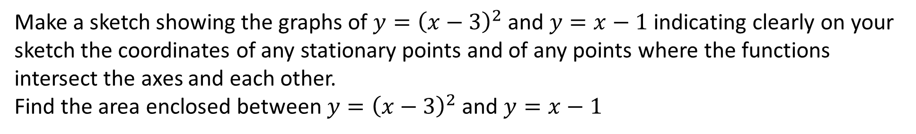
Guided Practice
Make a sketch showing the graphs of $y={\left(x−3\right)}^{2}$ and $y=x−1$ indicating clearly on your sketch the coordinates of any stationary points and of any points where the functions intersect the axes and each other.
Find the area enclosed between $y={\left(x−3\right)}^{2}$ and $y=x−1$

Slide 12





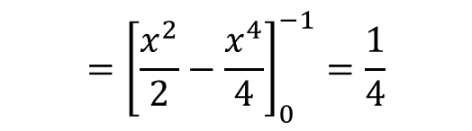
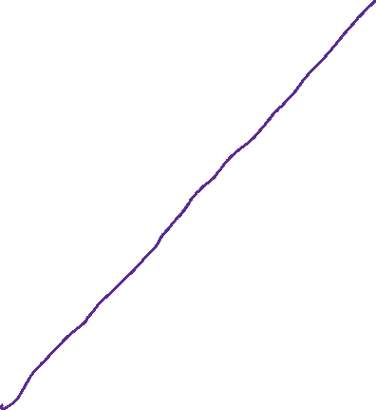




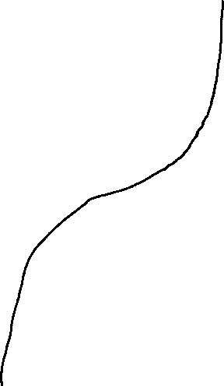
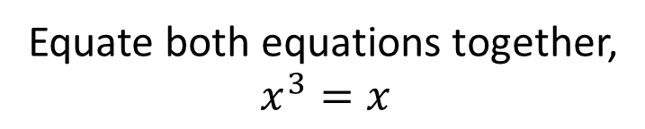
Guided Practice
Find the area of the region enclosed by the graphs $f\left(x\right)=x^{3}$ and $g(x)=x$
Step 1: Sketch the graph
Step 2: Determine the coordinates of intersection
Equate both equations together,
$$x^{3}=x$$
$$x^{3}−x=0$$
$$x(x^{2}−1)=0$$
$$x=0, x=±1$$
Area A $=−\int_{−1}^{0}{x}dx−\left(−\int_{−1}^{0}{x^{3}}dx\right)$
$$=\int_{0}^{−1}{x}dx−\int_{0}^{−1}{x^{3}}dx$$
$$={\left[\frac{x^{2}}{2}−\frac{x^{4}}{4}\right]}_{0}^{−1}=\frac{1}{4}$$
$$=\int_{0}^{−1}{x}−x^{3}dx$$

Slide 13


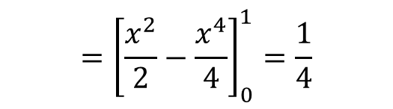
Guided Practice
Find the area of the region enclosed by the graphs $f\left(x\right)=x^{3}$ and $g(x)=x$
Area B $=\int_{0}^{1}{x}−x^{3} dx$
$$={\left[\frac{x^{2}}{2}−\frac{x^{4}}{4}\right]}_{0}^{1}=\frac{1}{4}$$
Total Area $=\frac{1}{4}+\frac{1}{4}=\frac{1}{2} units^{2}$

Slide 14
Independent Practice
Complete Cambridge Ex 6I

